Slide 1
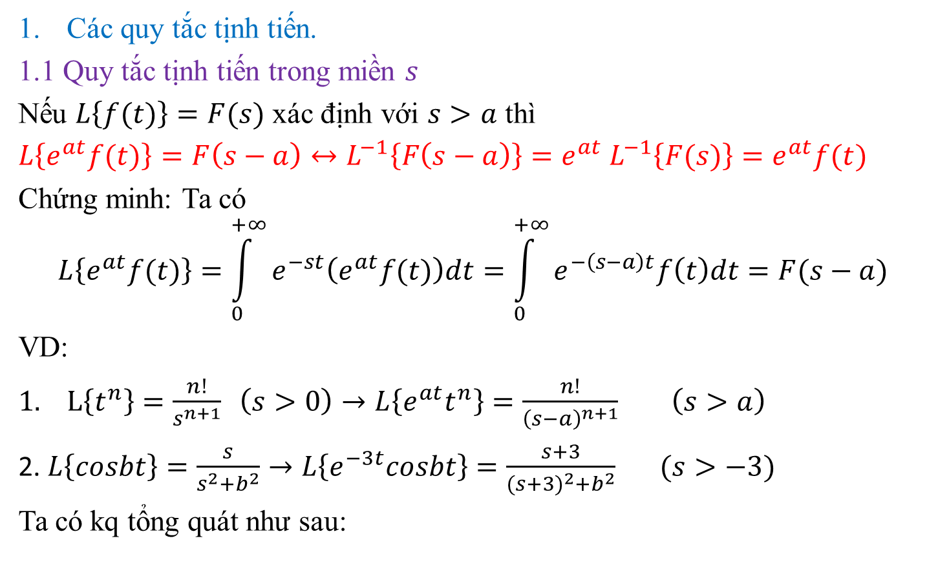
$3. Phép tịnh tiến và phân thức đơn giản
Các quy tắc tịnh tiến.
1.1 Quy tắc tịnh tiến trong miền $s$
Nếu $L\left\{f(t)\right\}=F(s)$ xác định với $s>a$ thì
$L\left\{e^{at}f(t)\right\}=F\left(s−a\right)↔L^{−1}\left\{F\left(s−a\right)\right\}=e^{at}$ $L^{−1}\left\{F(s)\right\}=e^{at}f(t)$
Chứng minh: Ta có
$$L\left\{e^{at}f(t)\right\}=\int_{0}^{+∞}{e^{−st}\left(e^{at}f(t)\right)dt=\int_{0}^{+∞}{e^{−\left(s−a\right)t}f\left(t\right)dt=F(s−a)}}$$
VD:
$L\left\{t^{n}\right\}=\frac{n!}{s^{n+1}} \left(s>0\right)→L\left\{e^{at}t^{n}\right\}=\frac{n!}{{\left(s−a\right)}^{n+1}}$ $\left(s>a\right)$
2. $L\left\{cosbt\right\}=\frac{s}{s^{2}+b^{2}}→L\left\{e^{−3t}cosbt\right\}=\frac{s+3}{{(s+3)}^{2}+b^{2}} (s>−3)$
Ta có kq tổng quát như sau:

Slide 2

KQ tổng quát
$L\left\{e^{at}cosbt\right\}=\frac{s−a}{{(s−a)}^{2}+b^{2}} (s>a)$
$L\left\{e^{at}sinbt\right\}=\frac{b}{{(s−a)}^{2}+b^{2}} (s>a)$
$L\left\{e^{at}coshbt\right\}=\frac{s−a}{{(s−a)}^{2}−b^{2}} (s>a)$
$L\left\{e^{at}sinhbt\right\}=\frac{b}{{(s−a)}^{2}−b^{2}} (s>a)$

Slide 3
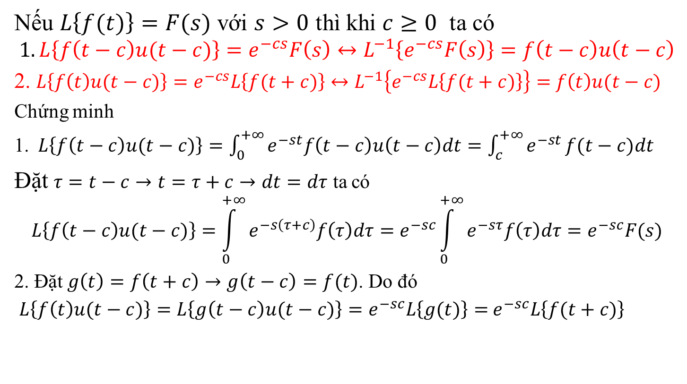
1.2 Quy tắc tịnh tiến trong miền $t$.
Nếu $L\left\{f(t)\right\}=F(s)$ với $s>0$ thì khi $c≥0$ ta có
$$1.L\left\{f\left(t−c\right)u(t−c)\right\}=e^{−cs}F\left(s\right)↔L^{−1}\left\{e^{−cs}F\left(s\right)\right\}=f\left(t−c\right)u\left(t−c\right)$$
2. $L\left\{f\left(t\right)u(t−c)\right\}=e^{−cs}L\left\{f(t+c)\right\}↔L^{−1}\left\{e^{−cs}L\left\{f(t+c)\right\}\right\}=$ $f\left(t\right)u(t−c)$
Chứng minh
1.$L\left\{f\left(t−c\right)u(t−c)\right\}=\int_{0}^{+∞}{e^{−st}f\left(t−c\right)u\left(t−c\right)dt=\int_{c}^{+∞}{e^{−st}}f(t−c})dt$
Đặt $τ=t−c→t=τ+c→dt=dτ$ ta có
$$L\left\{f\left(t−c\right)u(t−c)\right\}=\int_{0}^{+∞}{e^{−s\left(τ+c\right)}f\left(τ\right)dτ=e^{−sc}\int_{0}^{+∞}{e^{−sτ}f\left(τ\right)dτ=e^{−sc}F(s)}}$$
2. Đặt $g\left(t\right)=f\left(t+c\right)→g\left(t−c\right)=f(t)$. Do đó
$L\left\{f\left(t\right)u(t−c)\right\}=L\left\{g\left(t−c\right)u(t−c)\right\}=e^{−sc}L\left\{g(t)\right\}=$ $e^{−sc}L\left\{f(t+c)\right\}$

Slide 4
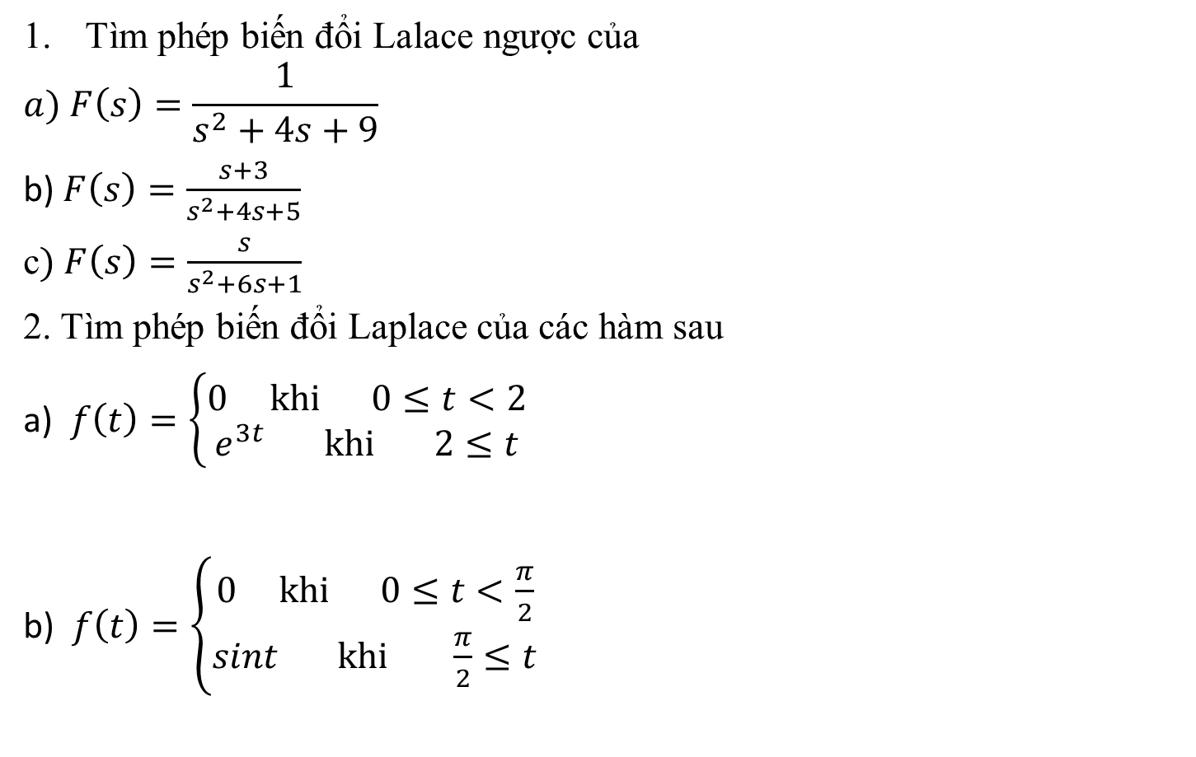
Một số ví dụ
Tìm phép biến đổi Lalace ngược của
$$a) F\left(s\right)=\frac{1}{s^{2}+4s+9}$$
b) $F\left(s\right)=\frac{s+3}{s^{2}+4s+5}$
c$) F\left(s\right)=\frac{s}{s^{2}+6s+1}$
2. Tìm phép biến đổi Laplace của các hàm sau
a) $f\left(t\right)=\left\{\begin{matrix}0 khi 0≤t<2 \\ e^{3t} khi 2≤t\end{matrix}\right.$
b) $f\left(t\right)=\left\{\begin{matrix}0 khi 0≤t<\frac{π}{2} \\ sint khi \frac{π}{2}≤t\end{matrix}\right.$

Slide 5

VD (tiếp)
3. Tìm biến đổi Laplace ngược các hàm số sau:
a) $F\left(s\right)=\frac{5e^{−6s}−3e^{−11s}}{\left(s^{2}+9\right)(s+2)}$
b) $F\left(s\right)=e^{−s}\frac{s+2}{s^{2}+2s+5}$
c) $F\left(s\right)=\frac{s\left(1−e^{−2s}\right)}{s^{2}+π^{2}}$

Slide 6
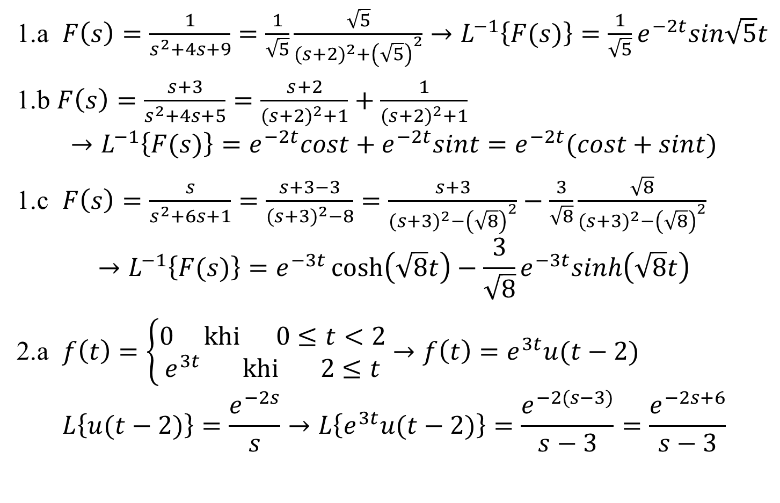
Lời giải
1.a $F\left(s\right)=\frac{1}{s^{2}+4s+9}=\frac{1}{\sqrt{5}}\frac{\sqrt{5}}{{(s+2)}^{2}+{\left(\sqrt{5}\right)}^{2}}→L^{−1}\left\{F(s)\right\}=\frac{1}{\sqrt{5}}e^{−2t}sin\sqrt{5}t$
1.b $F\left(s\right)=\frac{s+3}{s^{2}+4s+5}=\frac{s+2}{{(s+2)}^{2}+1}+\frac{1}{{(s+2)}^{2}+1}$
$$→L^{−1}\left\{F(s)\right\}=e^{−2t}cost+e^{−2t}sint=e^{−2t}(cost+sint)$$
1.c $F\left(s\right)=\frac{s}{s^{2}+6s+1}=\frac{s+3−3}{{(s+3)}^{2}−8}=\frac{s+3}{{(s+3)}^{2}−{\left(\sqrt{8}\right)}^{2}}−\frac{3}{\sqrt{8}}\frac{\sqrt{8}}{{(s+3)}^{2}−{\left(\sqrt{8}\right)}^{2}}$
$$→L^{−1}\left\{F(s)\right\}=e^{−3t}\cosh\left(\sqrt{8}t\right)−\frac{3}{\sqrt{8}}e^{−3t}sinh\left(\sqrt{8}t\right)$$
2.a $f\left(t\right)=\left\{\begin{matrix}0 khi 0≤t<2 \\ e^{3t} khi 2≤t\end{matrix}\right.$ $→f\left(t\right)=e^{3t}u(t−2)$
$$L\left\{u(t−2)\right\}=\frac{e^{−2s}}{s}→L\left\{e^{3t}u(t−2)\right\}=\frac{e^{−2(s−3)}}{s−3}=\frac{e^{−2s+6}}{s−3}$$

Slide 7
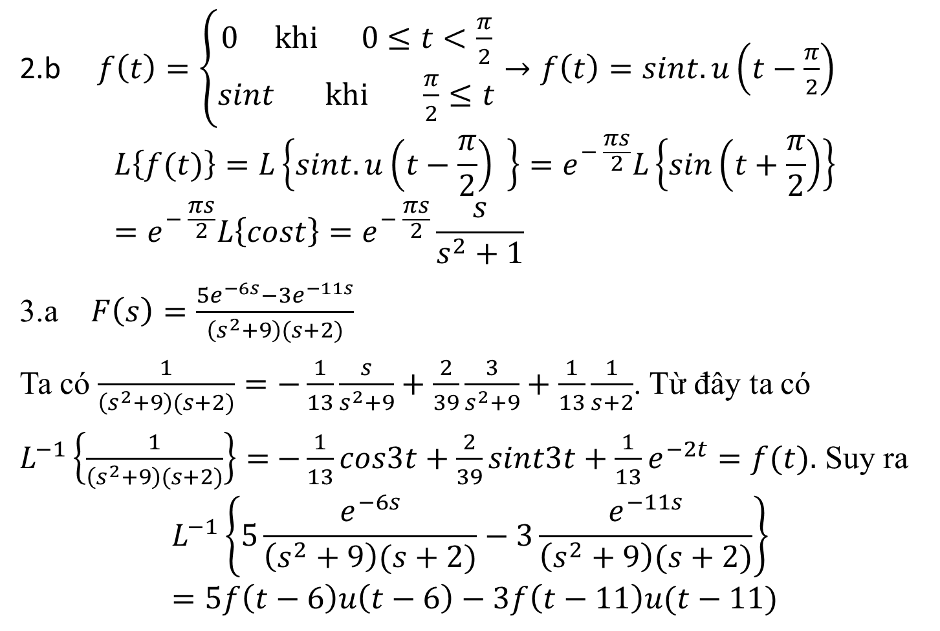
Giải tiếp
2.b $f\left(t\right)=\left\{\begin{matrix}0 khi 0≤t<\frac{π}{2} \\ sint khi \frac{π}{2}≤t\end{matrix}\right.→f\left(t\right)=sint.u\left(t−\frac{π}{2}\right)$
$$L\left\{f(t)\right\}=L\left\{sint.u\left(t−\frac{π}{2}\right) \right\}=e^{− \frac{πs}{2}}L\left\{sin\left(t+\frac{π}{2}\right)\right\}=e^{− \frac{πs}{2}}L\left\{cost\right\}=e^{− \frac{πs}{2}}\frac{s}{s^{2}+1}$$
3.a $F\left(s\right)=\frac{5e^{−6s}−3e^{−11s}}{\left(s^{2}+9\right)(s+2)}$
Ta có $\frac{1}{\left(s^{2}+9\right)(s+2)}=−\frac{1}{13}\frac{s}{s^{2}+9}+\frac{2}{39}\frac{3}{s^{2}+9}+\frac{1}{13}\frac{1}{s+2}$. Từ đây ta có
$L^{−1}\left\{\frac{1}{\left(s^{2}+9\right)(s+2)}\right\}=$ $−\frac{1}{13}cos3t+\frac{2}{39}sint3t+\frac{1}{13}e^{−2t}=f(t).$ Suy ra
$$L^{−1}\left\{5\frac{e^{−6s}}{\left(s^{2}+9\right)(s+2)}−3\frac{e^{−11s}}{\left(s^{2}+9\right)(s+2)}\right\}=5f\left(t−6\right)u\left(t−6\right)−3f\left(t−11\right)u(t−11)$$

Slide 8
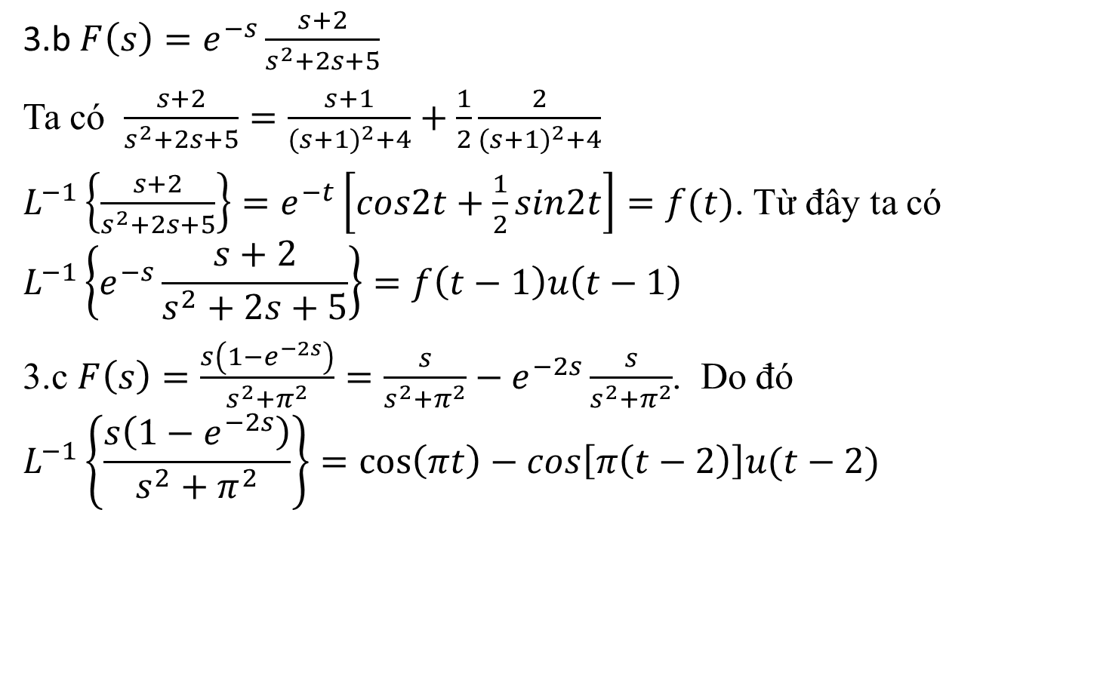
Giải tiếp
3.b $F\left(s\right)=e^{−s}\frac{s+2}{s^{2}+2s+5}$
Ta có $\frac{s+2}{s^{2}+2s+5}=\frac{s+1}{{(s+1)}^{2}+4}+\frac{1}{2}\frac{2}{{(s+1)}^{2}+4}$
$L^{−1}\left\{\frac{s+2}{s^{2}+2s+5}\right\}=e^{−t}\left[cos2t+\frac{1}{2}sin2t\right]=f(t)$. Từ đây ta có
$$L^{−1}\left\{e^{−s}\frac{s+2}{s^{2}+2s+5}\right\}=f\left(t−1\right)u\left(t−1\right)$$
3.c $F\left(s\right)=\frac{s\left(1−e^{−2s}\right)}{s^{2}+π^{2}}=\frac{s}{s^{2}+π^{2}}−e^{−2s}\frac{s}{s^{2}+π^{2}}$. Do đó
$$L^{−1}\left\{\frac{s\left(1−e^{−2s}\right)}{s^{2}+π^{2}}\right\}=\cos\left(πt\right)−cos\left[π\left(t−2\right)\right]u(t−2)$$

Slide 9
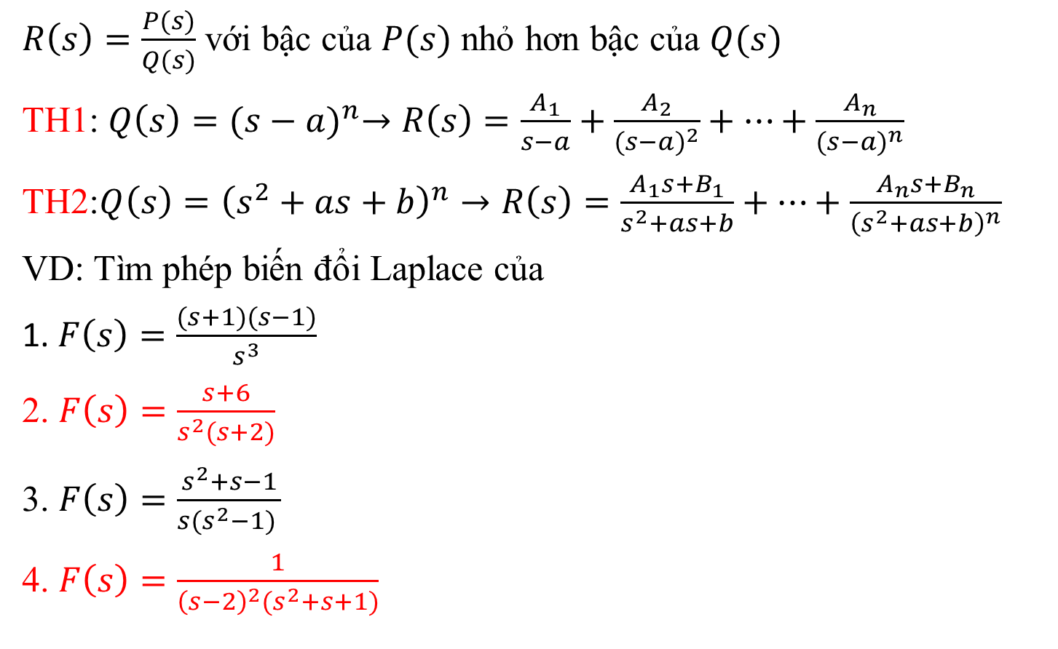
2. Phân thức hữu tỷ
$R\left(s\right)=\frac{P(s)}{Q(s)}$ với bậc của $P(s)$ nhỏ hơn bậc của $Q(s)$
TH1: $Q\left(s\right)={(s−a)}^{n}→R\left(s\right)=\frac{A_{1}}{s−a}+\frac{A_{2}}{{(s−a)}^{2}}+⋯+\frac{A_{n}}{{(s−a)}^{n}}$
TH2:$Q\left(s\right)={\left(s^{2}+as+b\right)}^{n}→R\left(s\right)=\frac{A_{1}s+B_{1}}{s^{2}+as+b}+⋯+\frac{A_{n}s+B_{n}}{{\left(s^{2}+as+b\right)}^{n}}$
VD: Tìm phép biến đổi Laplace của
1. $F\left(s\right)=\frac{(s+1)(s−1)}{s^{3}}$
2. $F\left(s\right)=\frac{s+6}{s^{2}(s+2)}$
3. $F\left(s\right)=\frac{s^{2}+s−1}{{s(s}^{2}−1) }$
4. $F\left(s\right)=\frac{1}{{\left(s−2\right)}^{2}(s^{2}+s+1)}$

Slide 10
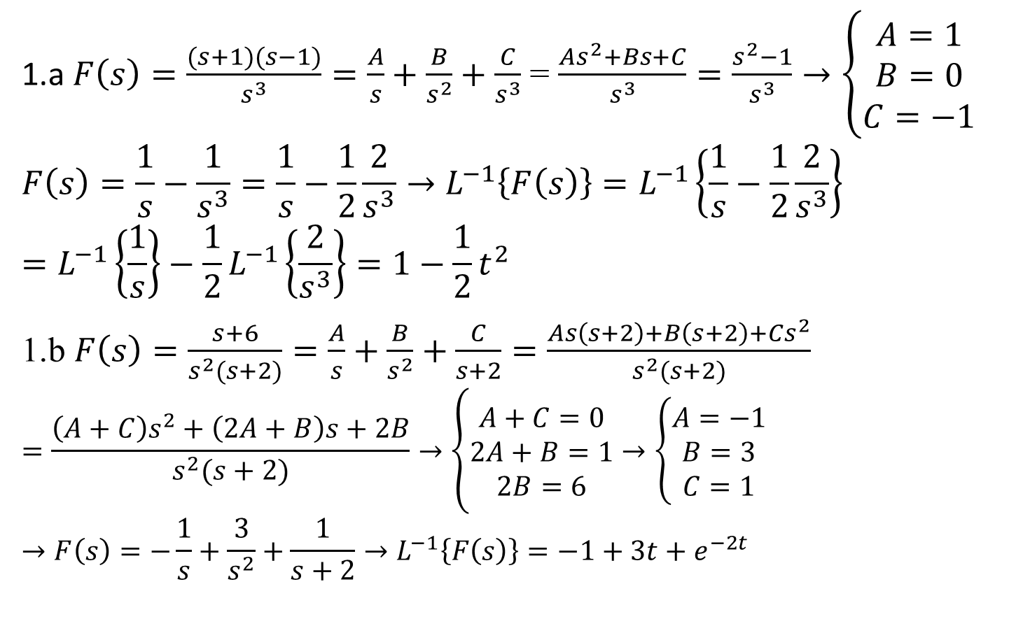
Giải
1.a $F\left(s\right)=\frac{(s+1)(s−1)}{s^{3}}=\frac{A}{s}+\frac{B}{s^{2}}+\frac{C}{s^{3}}$ = $\frac{As^{2}+Bs+C}{s^{3}}=\frac{s^{2}−1}{s^{3}}→\left\{\begin{matrix}A=1 \\ B=0 \\ C=−1\end{matrix}\right.$
$$F\left(s\right)=\frac{1}{s}−\frac{1}{s^{3}}=\frac{1}{s}−\frac{1}{2}\frac{2}{s^{3}}→L^{−1}\left\{F\left(s\right)\right\}=L^{−1}\left\{\frac{1}{s}−\frac{1}{2}\frac{2}{s^{3}}\right\}=L^{−1}\left\{\frac{1}{s}\right\}−\frac{1}{2}L^{−1}\left\{\frac{2}{s^{3}}\right\}=1−\frac{1}{2}t^{2}$$
1.b $F\left(s\right)=\frac{s+6}{s^{2}(s+2)}=\frac{A}{s}+\frac{B}{s^{2}}+\frac{C}{s+2}=\frac{As\left(s+2\right)+B\left(s+2\right)+Cs^{2}}{s^{2}(s+2)}$
$$=\frac{\left(A+C\right)s^{2}+\left(2A+B\right)s+2B}{s^{2}(s+2)}→\left\{\begin{matrix}A+C=0 \\ 2A+B=1 \\ 2B=6\end{matrix}→\left\{\begin{matrix}A=−1 \\ B=3 \\ C=1\end{matrix}\right.\right.$$
$$→F\left(s\right)=−\frac{1}{s}+\frac{3}{s^{2}}+\frac{1}{s+2}→L^{−1}\left\{F\left(s\right)\right\}=−1+3t+e^{−2t}$$

Slide 11
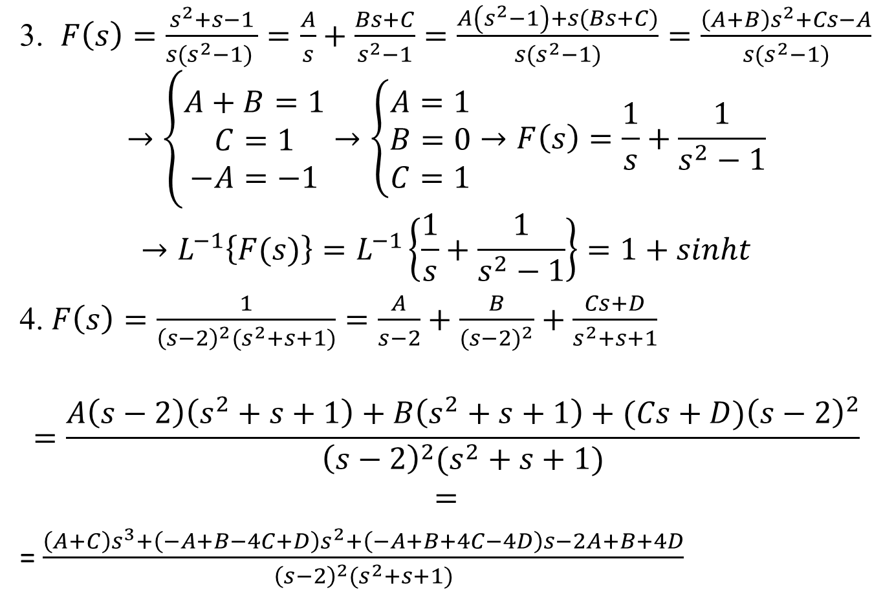
Giải (tiếp)
3. $F\left(s\right)=\frac{s^{2}+s−1}{{s(s}^{2}−1) }=\frac{A}{s}+\frac{Bs+C}{s^{2}−1}=\frac{A\left(s^{2}−1\right)+s(Bs+C)}{{s(s}^{2}−1)}=\frac{\left(A+B\right)s^{2}+Cs−A}{{s(s}^{2}−1)}$
$$→\left\{\begin{matrix}A+B=1 \\ C=1 \\ −A=−1\end{matrix}→\left\{\begin{matrix}A=1 \\ B=0 \\ C=1\end{matrix}→F\left(s\right)=\frac{1}{s}+\frac{1}{s^{2}−1}\right.\right.$$
$$→L^{−1}\left\{F(s)\right\}=L^{−1}\left\{\frac{1}{s}+\frac{1}{s^{2}−1}\right\}=1+sinht$$
4. $F\left(s\right)=\frac{1}{{\left(s−2\right)}^{2}(s^{2}+s+1)}=\frac{A}{s−2}+\frac{B}{{(s−2)}^{2}}+\frac{Cs+D}{s^{2}+s+1}$
$$=\frac{A\left(s−2\right)\left(s^{2}+s+1\right)+B\left(s^{2}+s+1\right)+(Cs+D){\left(s−2\right)}^{2}}{{\left(s−2\right)}^{2}(s^{2}+s+1)}$$
$$=$$
= $\frac{\left(A+C\right)s^{3}+\left(−A+B−4C+D\right)s^{2}+\left(−A+B+4C−4D\right)s−2A+B+4D}{{\left(s−2\right)}^{2}(s^{2}+s+1)}$

Slide 12
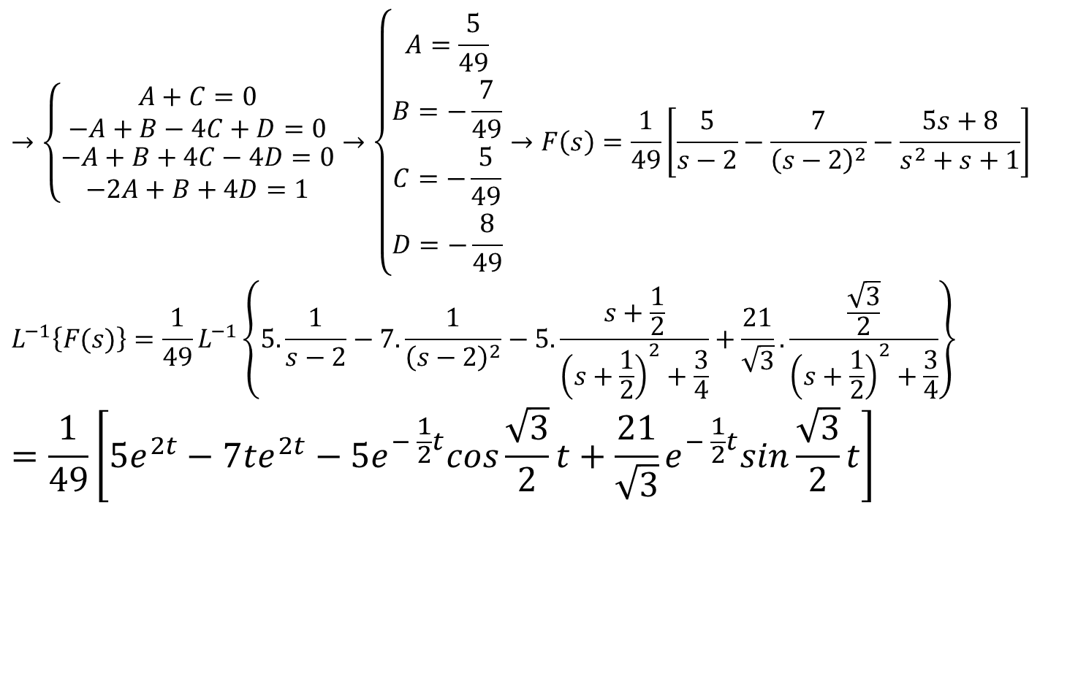
Tiếp câu 4
$$→\left\{\begin{matrix}A+C=0 \\ −A+B−4C+D=0 \\ \begin{aligned}−A+B+4C−4D=0 \\ −2A+B+4D=1\end{aligned}\end{matrix}\right.→\left\{\begin{matrix}A=\frac{5}{49} \\ B=−\frac{7}{49} \\ \begin{aligned}C=−\frac{5}{49} \\ D=−\frac{8}{49}\end{aligned}\end{matrix}\right.→F\left(s\right)=\frac{1}{49}\left[\frac{5}{s−2}−\frac{7}{{\left(s−2\right)}^{2}}−\frac{5s+8}{s^{2}+s+1}\right]$$
$$L^{−1}\left\{F(s)\right\}=\frac{1}{49}L^{−1}\left\{5.\frac{1}{s−2}−7.\frac{1}{{\left(s−2\right)}^{2}}−5.\frac{s+\frac{1}{2}}{{\left(s+\frac{1}{2}\right)}^{2}+\frac{3}{4}}+\frac{21}{\sqrt{3}}.\frac{\frac{\sqrt{3}}{2}}{{\left(s+\frac{1}{2}\right)}^{2}+\frac{3}{4}}\right\}$$
$$=\frac{1}{49}\left[5e^{2t}−7te^{2t}−5e^{− \frac{1}{2}t}cos\frac{\sqrt{3}}{2}t+\frac{21}{\sqrt{3}}e^{− \frac{1}{2}t}sin\frac{\sqrt{3}}{2}t\right]$$

